Slide 1
Perceptron Model

Slide 2
Perceptron Model
Perceptron is Machine Learning algorithm for supervised learning of various binary classification tasks
Perceptron model is also treated as one of the best and simplest types of Artificial Neural networks. However, it is a supervised learning algorithm of binary classifiers. Hence, we can consider it as a single-layer neural network with four main parameters, i.e., input values, weights and Bias, net sum, and an activation function.

Slide 3
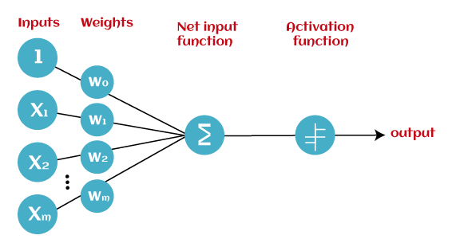
Basic Components of Perceptron
Mr. Frank Rosenblatt invented the perceptron model as a binary classifier which contains three main components. These are as follows:

Slide 4
Cont.
Input Nodes or Input Layer:
This is the primary component of Perceptron which accepts the initial data into the system for further processing. Each input node contains a real numerical value.
Wight and Bias:
Weight parameter represents the strength of the connection between units. This is another most important parameter of Perceptron components. Weight is directly proportional to the strength of the associated input neuron in deciding the output. Further, Bias can be considered as the line of intercept in a linear equation.
Activation Function:
These are the final and important components that help to determine whether the neuron will fire or not. Activation Function can be considered primarily as a step function.

Slide 5
Types of Perceptron Model
Based on the layers, Perceptron models are divided into two types. These are as follows:
Single-layer Perceptron Model
Multi-layer Perceptron model

Slide 6
Single layer Perceptron Network
This is one of the easiest Artificial neural networks (ANN) types.
A single-layered perceptron model consists feed-forward network and also includes a threshold transfer function inside the model.
The main objective of the single-layer perceptron model is to analyze the linearly separable objects with binary outcomes.
Single-layer perceptron can learn only linearly separable patterns.

Slide 7
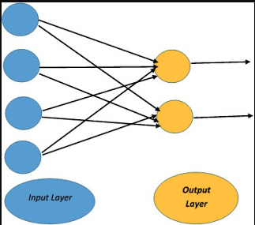
Cont.
Single Layer Perceptron has just two layers of input and output. It only has single layer hence the name single layer perceptron. It does not contain Hidden Layers as that of Multilayer perceptron.

Slide 8
Multi-Layer Perceptron (MLP)
A multilayer perceptron is a type of feed-forward artificial neural network that generates a set of outputs from a set of inputs.
An MLP is a neural network connecting multiple layers in a directed graph, which means that the signal path through the nodes only goes one way.
The MLP network consists of input, output, and hidden layers.

Slide 9
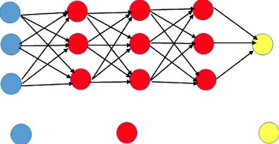
Cont.

Slide 10
Perceptron Learning Steps
Features of the model we want to train should be passed as input to the perceptrons in the first layer.
These inputs will be multiplied by the weights or weight coefficients and the production values from all perceptrons will be added.
Adds the Bias value, to move the output function away from the origin.
This computed value will be fed to the activation function (chosen based on the requirement, if a simple perceptron system activation function is step function).
The result value from the activation function is the output value.

Slide 11
Back Propagation
Network

Slide 12
Back Propagation Network Definition and Architecture
Back Propagation learning Algorithm is one of the most important developments in neural networks.
This learning algorithm is applied to the feed-forward networks (multilayer) consisting of processing elements with continuous differential activation functions.
A back propagation neural network is a multilayer, feed-forward neural network consisting of an input layer, hidden layer and an output layer. The neurons present in the hidden and output layers have biases, which are the connections from the units whose activation is always 1. The bias term also acts as weights. During the back-propagation phase of learning signals are sent in the reverse directions.

Slide 13
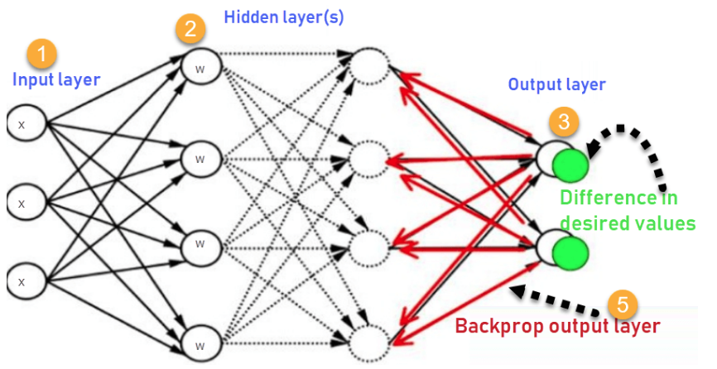
Cont.

Slide 14
Back Propagation Algorithm
Step 1: Inputs X, arrive through the preconnected path.
Step 2: The input is modeled using true weights W. Weights are usually chosen randomly.
Step 3: Calculate the output of each neuron from the input layer to the hidden layer to the output layer.
Step 4: Calculate the error in the outputs
Backpropagation Error= Actual Output – Desired Output
Step 5: From the output layer, go back to the hidden layer to adjust the weights to reduce the error.
Step 6: Repeat the process until the desired output is achieved.

Slide 15
Learning Factors
The training of a back propagation network is based on the choice of the various parameters.
Initial weights:
The ultimate solution may be affected by the initial weights of a multilayer feed-forward network. They are initialized at small random values.
Learning rate
The learning rate affects the convergence of the BPN. A large value of the learning rate may speed up the convergence but might result in overshooting, while a smaller value has an vice-versa effect.

Slide 16
Cont..
Momentum Factor: The Momentum Factor is denoted by n E [0, 1] and the value of 0.9 is often used for the momentum factor. Also, this approach is more useful when some training data are very different from the majority of data. A momentum factor can be used with either pattern by pattern updating or batch mode updating. Momentum is a technique used in backpropagation to speed up the learning process of neural networks.
Generalization
Number of Training Data
Number of hidden layer nodes

Slide 17
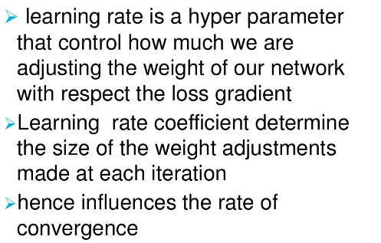
Effect of learning coefficients

Slide 18
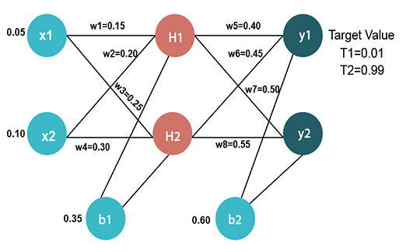
Problem of Back Propagation Network
Solution at https://docs.google.com/document/d/1DXQ5BDqi9AytqWsvQzGZwCPBk0OG_077YoOictb24qs/edit?usp=sharing

Slide 19
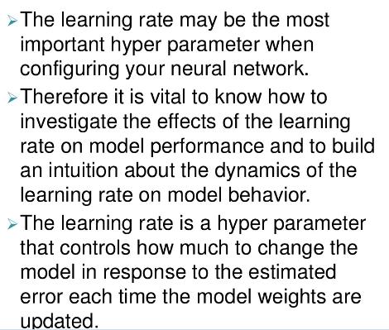
Cont.

Slide 20
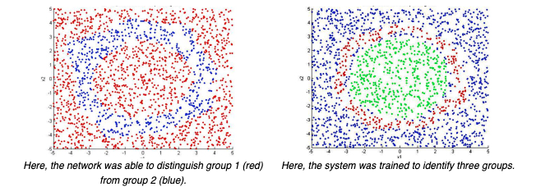
Application of Back Propagation Network
Application #1: Classification
In this classification problem, the goal is to identify whether a certain "data point" belongs to Class 1, 2, or 3 (see above). Random points are assigned to a certain class, and the neural network is trained to find the pattern. When training is complete, it will use what it has learned to accurately classify new points.

Slide 21
Cont.
It is used in the field of speech recognition
It is used in the field of character and face recognition

Slide 22
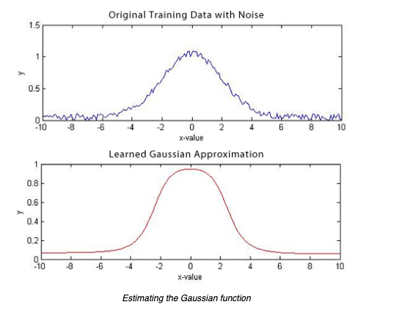
Cont.
In this problem, the network tries to approximate the value of a certain function. It is fed with noisy data, and the goal is to find the true pattern. After training, the network successfully estimates the value of the gaussian function (below).

Slide 23
Limitations of Back Propagation
Backpropagation could be rather sensitive to noisy data and irregularity.
The performance of backpropagation relies very heavily on the training data. Performance is highly dependent on input data.
Backpropagation needs a very large amount of time for training.
Backpropagation requires a matrix-based method instead of mini-batch.

Slide 24
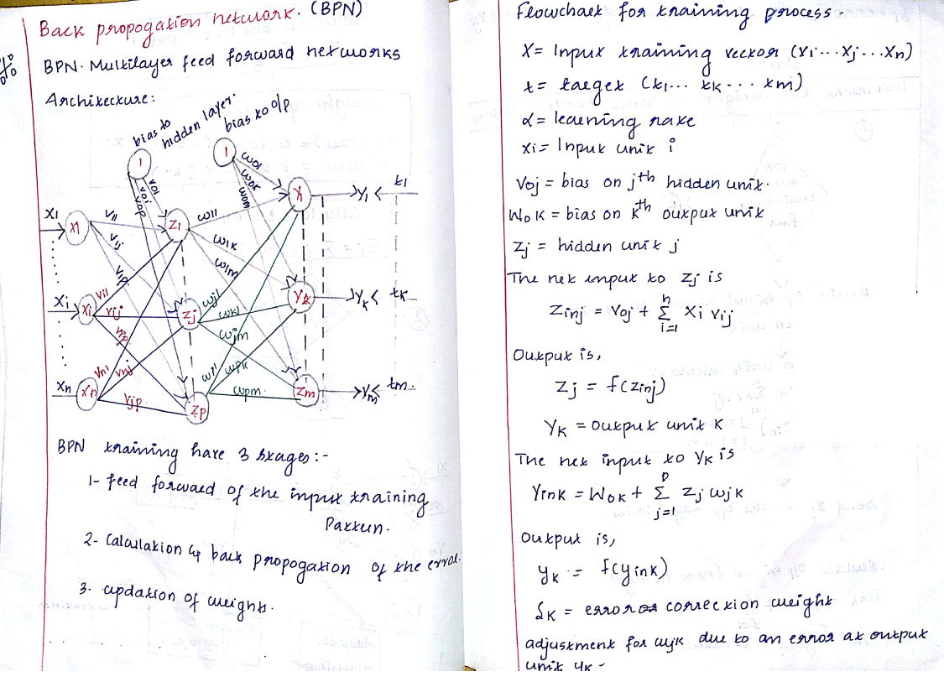

Slide 25
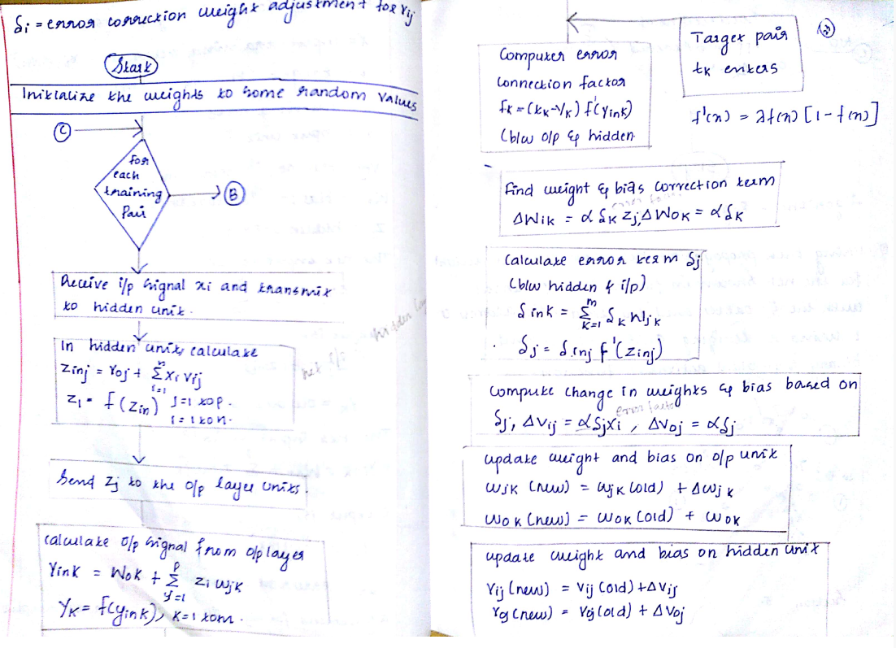

Slide 26
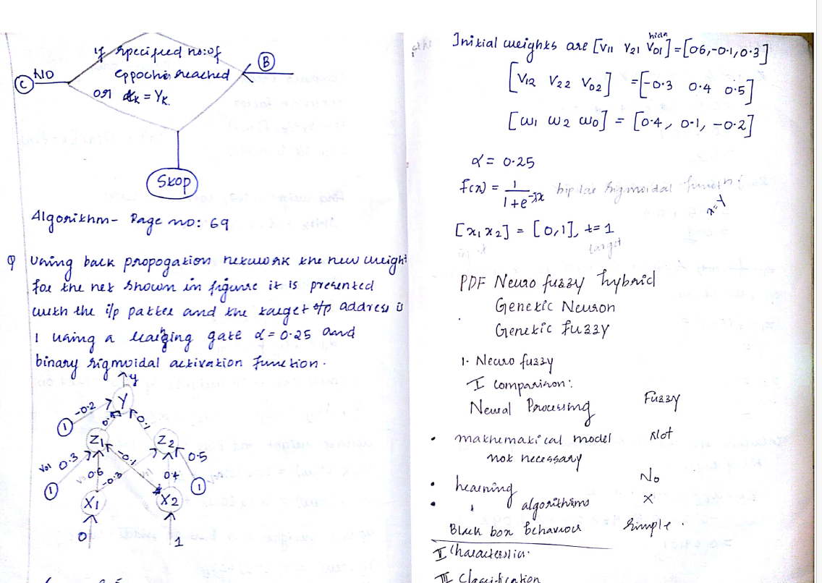

Slide 27
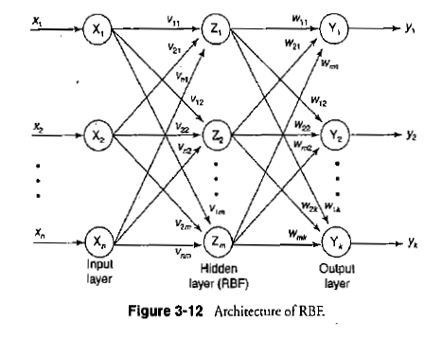
Radial basis function Network
Radial Basis Function (RBF) Networks are a particular type of Artificial Neural Network used for function approximation problems. RBF Networks differ from other neural networks in their three-layer architecture, universal approximation, and faster learning speed.
Use Gaussian Potential Function
F(x)= exp(-x^2)
Note: To expand/compress used functions can be Multiquadric, Inverse Multiquadric, and gaussian function.

Slide 28
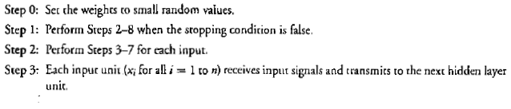
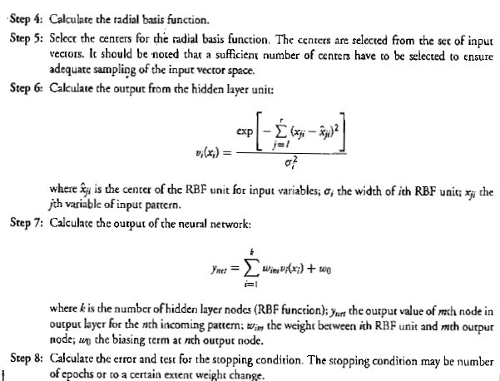
Training Algorithm

Slide 29
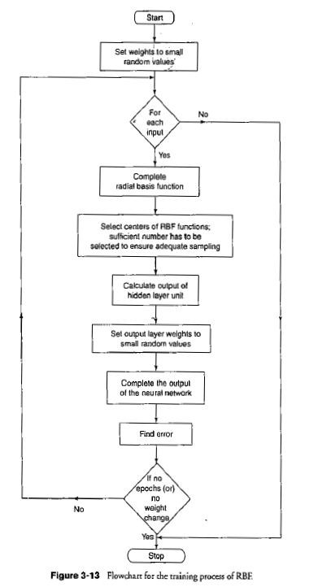
Flowchart for Training Process

Slide 31
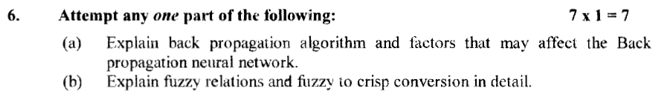
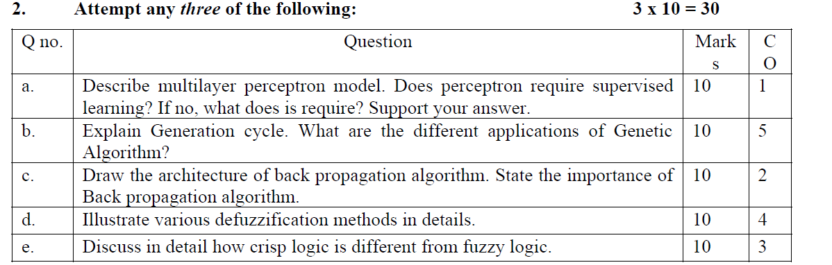
AKTU Questions
2019-2020, 2020-2021

Slide 32
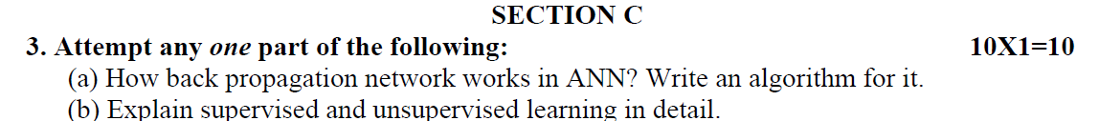
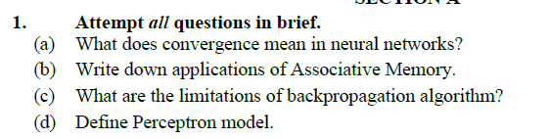
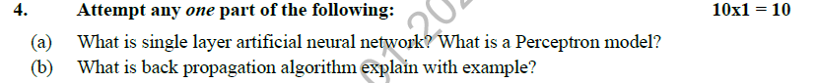
AKTU Questions
2021-2022, 22-23

